Slide 1

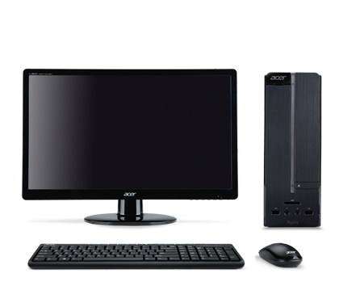
Pentaho Server
Processor: 4 cores
RAM: 16 GB
Disk Space: 500 GB
Networked
Internet Access
Ubuntu Server 16.04 LTS
Pentaho Server
Repository
MySQL CE 8.0.11
MonetDB 5
Pentaho Clients 1 to 3
Processor: 4 cores
RAM: 16 GB
Disk Space: 500 GB
Networked
Internet Access
Microsoft Windows 10
Pentaho Aggregation Designer
Pentaho Data Integration
Pentaho Metadata Editor
Pentaho Report Designer
Pentaho Schema Workbench

